Slide 1


STELLANTIS SPAIN
Trade-in websites performance review December 2025– spain
December 2025

Slide 2
Agenda
EXECUTIVE SUMMARY
PERFORMANCE OVERVIEW
SALES PERFORMANCE
LEADS FOCUS
DEEP DIVE ANALYSIS
OPEN POINTS
APPENDIX
December 2025

Slide 3
EXECUTIVE SUMMARY
Sum-up of trade-in performance
Main takeways ….
Source: autobiz

Slide 4

EXECUTIVE SUMMARY
Global view
PH_TBL
Source: autobiz

Slide 5
Agenda
EXECUTIVE SUMMARY
PERFORMANCE OVERVIEW
SALES PERFORMANCE
LEADS FOCUS
DEEP DIVE ANALYSIS
OPEN POINTS
APPENDIX
December 2025

Slide 6
EXECUTIVE SUMMARY
Leads evolution by month
PH_TBL
All leads
NC leads
Source: autobiz

Slide 7
EXECUTIVE SUMMARY
Leads by purchase project - xP brands
PH_TBL
Source: autobiz

Slide 8
EXECUTIVE SUMMARY
Leads by purchase project - xF brands
PH_TBL
Source: autobiz

Slide 9
EXECUTIVE SUMMARY
Traffic and lead view by brand xP
Traffic (Sessions)
PH_LKR_1
Leads
PH_LKR_2
Source : GA4/Autobiz
December 2025

Slide 10
EXECUTIVE SUMMARY
Traffic and lead view by brand xF
Traffic (Sessions)
PH_LKR_1
Leads
PH_LKR_2
Source : GA4/Autobiz
December 2025

Slide 11

LEADS PROJECTION
Total leads
Total leads - data till Jan 9th
PH_TBL
Jan. 2026
Source: autobiz

Slide 12
LEADS PROJECTION
NC leads
NC leads - data till Jan 9th
PH_TBL
Jan. 2026
Source: autobiz

Slide 13
Agenda
EXECUTIVE SUMMARY
PERFORMANCE OVERVIEW
SALES PERFORMANCE
LEADS FOCUS
DEEP DIVE ANALYSIS
OPEN POINTS
APPENDIX
December 2025

Slide 14
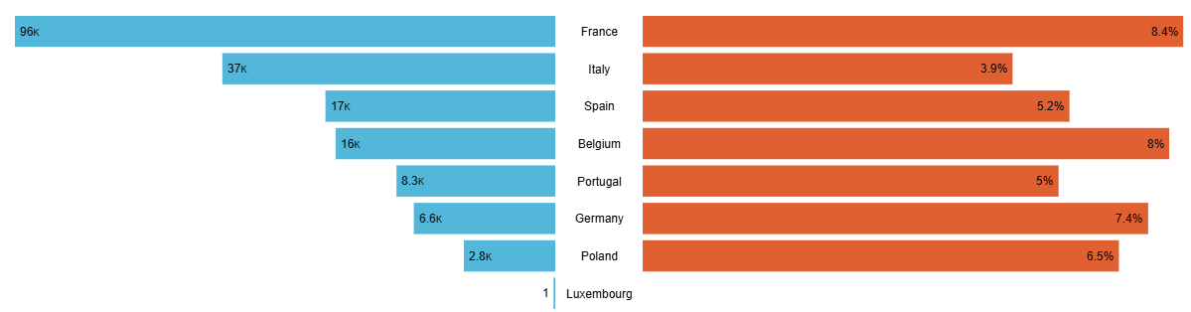
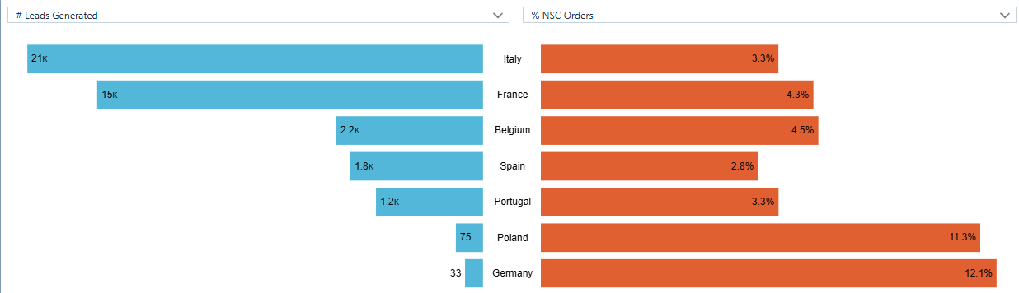
NC Sales Conversion
Analysis of Conversion Rates from jan 1st to December 31th 2025
A MAJ
xP dealers
xF dealers
Source : C1ST, 2024:2025 Lead VN type 1 , Extraction done on Jan 6th 2026
*Since orders can be placed up to three months after a lead is received, these figures are subject to daily changes

Slide 15
NC Sales Conversion
Analysis of Conversion Rates from jan 1st to December 31th 2025
A MAJ
NC leads experienced a 114% year-over-year increase. Within the xP segment, Opel is the only brand to record a decrease in lead volume.
Sales expanded across all xP brands except Opel, with 487 additional units sold in 2025 compared to 2024, representing a 57-unit month-over-month increase.
In the xF category, NC leads grew by 10%, although sales declined by 18 vehicles year-over-year, despite a 4-unit month-over-month rise.
Source : C1ST, 2024:2025 Lead VN type 1 , Extraction done on December 12th
*Since orders can be placed up to three months after a lead is received, these figures are subject to daily changes

Slide 16
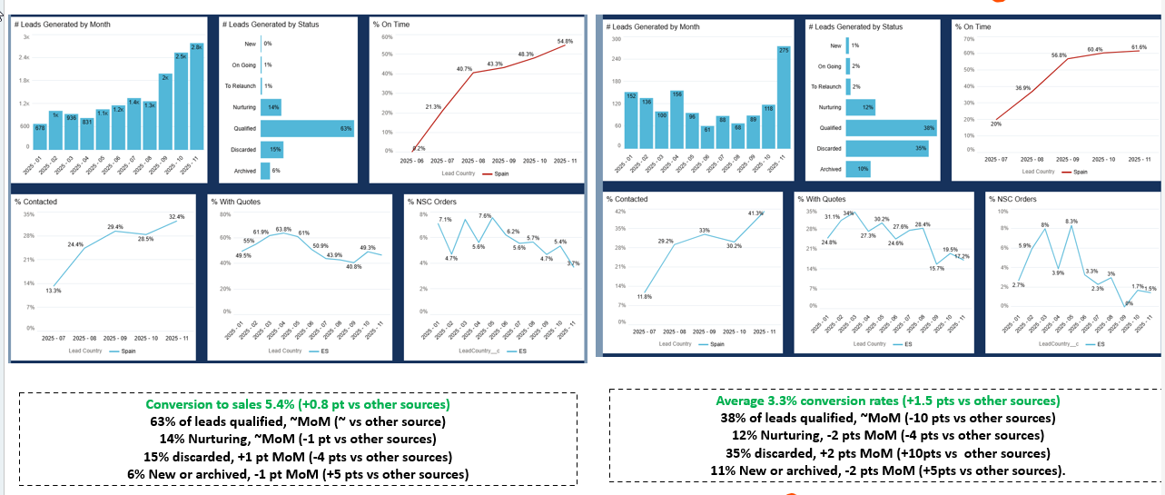
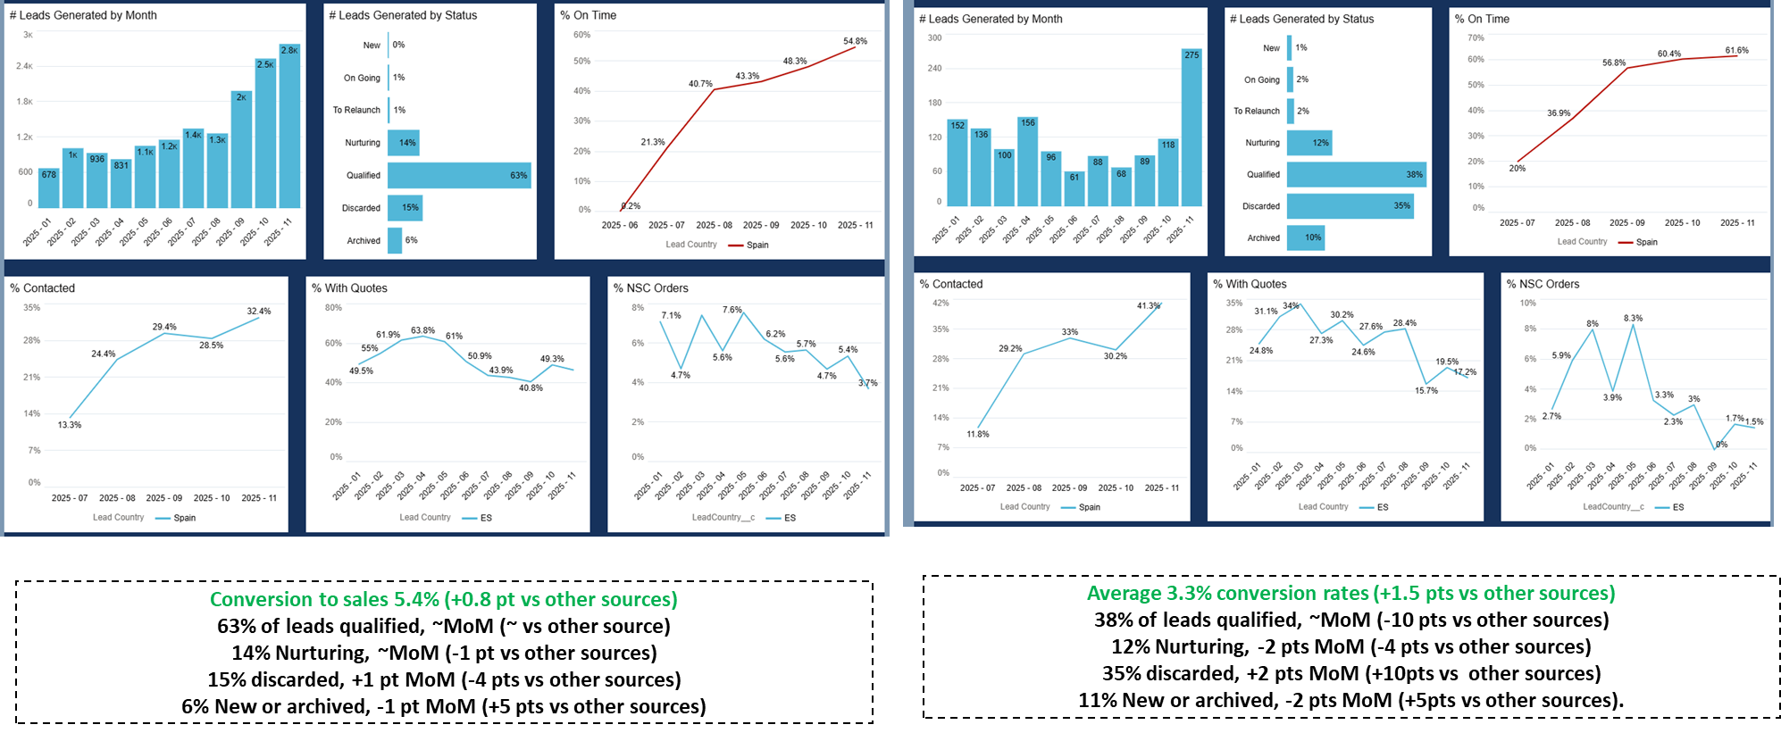
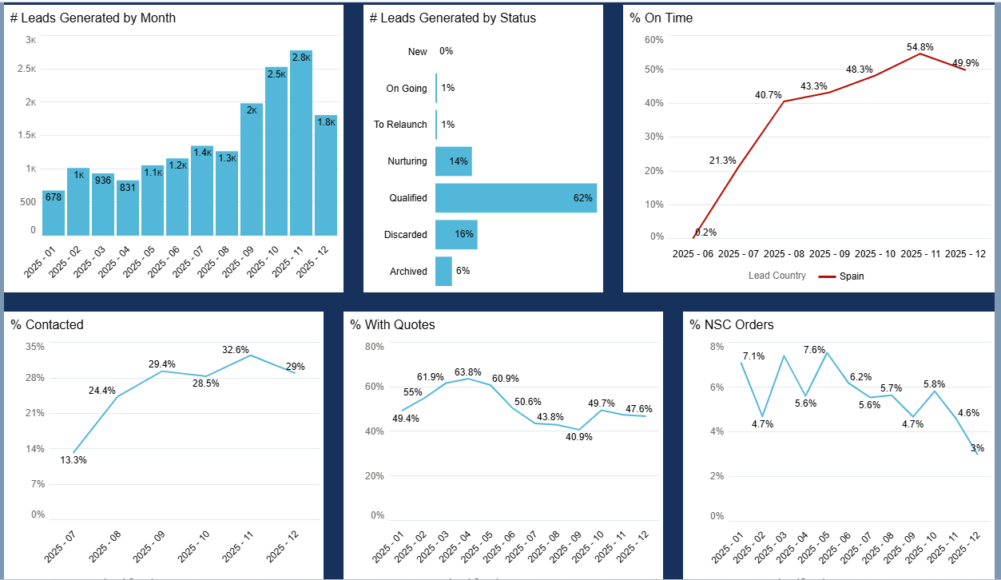
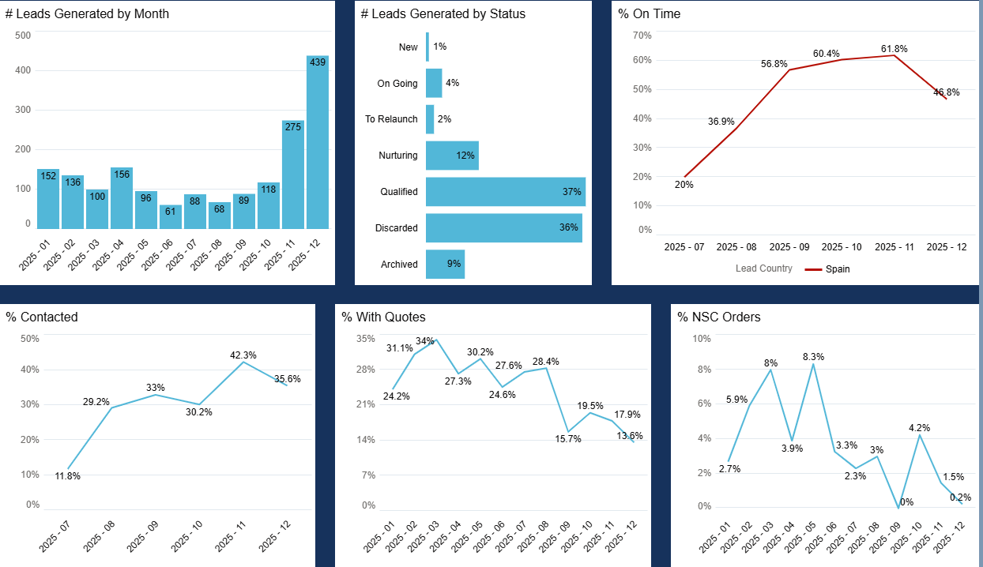
SALES PERFORMANCE
autobiz lead management - VN type 1 – C1ST
xP
xF
A MAJ
Conversion to sales 5.3% (+0.6 pt vs other sources)
62% of leads qualified, -1pt MoM (-1 vs other source)
14% Nurturing, ~MoM (~ vs other sources)
16% discarded, +1 pt MoM (-2 pts vs other sources)
6% New or archived, ~MoM (+4 pts vs other sources)
Average 2.8% conversion rates (+1 pt vs other sources)
37% of leads qualified, -1pt MoM (-11 pts vs other sources)
12% Nurturing, -~ MoM (-4 pts vs other sources)
36% discarded, +1 pt MoM (+11pts vs other sources)
10% New or archived, -1 pt MoM (+4pts vs other sources).
Source : C1ST, 2024:2025 Lead VN type 1 , Extraction done on December 12th
*Since orders can be placed up to three months after a lead is received, these figures are subject to daily changes
JAN 2025
Notes:
Decrease of the leads treated (-3%)
Increase for the L.T.O.T vs Q2 (+1,9%)
Decrease of the L.W.Q (-5%)

Slide 17
Agenda
EXECUTIVE SUMMARY
PERFORMANCE OVERVIEW
SALES PERFORMANCE
LEADS FOCUS
DEEP DIVE ANALYSIS
OPEN POINTS
APPENDIX
December 2025

Slide 18

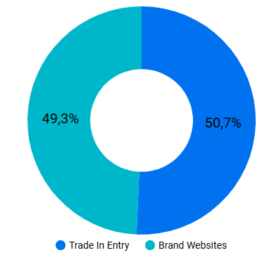
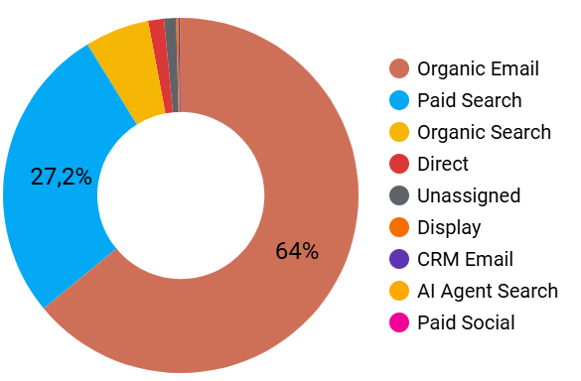
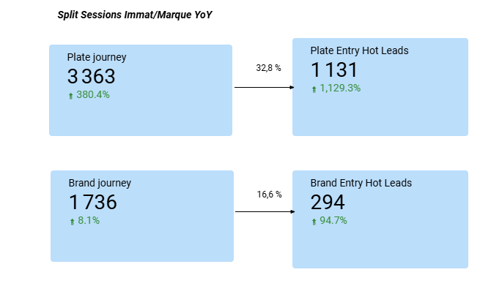
TRAFFICS DEEP DIVE
Traffic
PH_LKR_1
Source : GA4/Autobiz
December 2025

Slide 19
LEAD DEEP DIVE
By acquisition channel
PH_TBL
Source : Autobiz
December 2025

Slide 20
LEAD DEEP DIVE
By main website CTA
PH_TBL
Source : Autobiz
December 2025

Slide 21
LEAD DEEP DIVE
By marketing code
PH_TBL
Source : Autobiz
December 2025

Slide 22
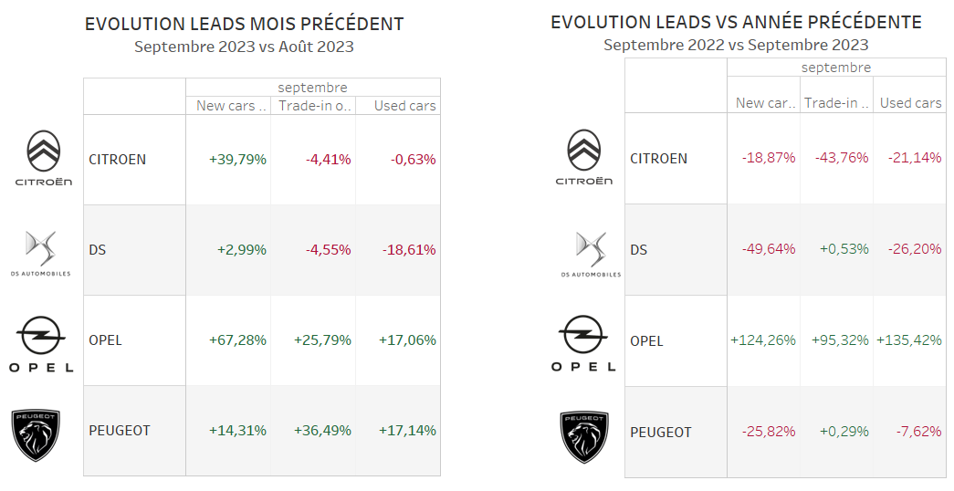
TRAFFICS DEEP DIVE
Traffic
PH_LKR_1
Source : GA4/Autobiz
December 2025

Slide 23
LEAD DEEP DIVE
By acquisition channel
PH_TBL
Source : Autobiz
December 2025

Slide 24
LEAD DEEP DIVE
By main website CTA
PH_TBL
Display the different CTA related to main website source
Source : Autobiz
December 2025

Slide 25
LEAD DEEP DIVE
By marketing code
PH_TBL
Source : Autobiz
December 2025

Slide 26

TRAFFICS DEEP DIVE
Traffic
PH_LKR_1
Source : GA4/Autobiz
December 2025

Slide 27
LEAD DEEP DIVE
By acquisition channel
PH_TBL
Source : Autobiz
December 2025

Slide 28
LEAD DEEP DIVE
By main website CTA
PH_TBL
Display the different CTA related to main website source
Source : Autobiz
December 2025

Slide 29
LEAD DEEP DIVE
By marketing code
PH_TBL
Source : Autobiz
December 2025

Slide 30

TRAFFICS DEEP DIVE
Traffic
PH_LKR_1
Source : GA4/Autobiz
December 2025

Slide 31
LEAD DEEP DIVE
By acquisition channel
PH_TBL
Source : Autobiz
December 2025

Slide 32
LEAD DEEP DIVE
By main website CTA
PH_TBL
Display the different CTA related to main website source
Source : Autobiz
December 2025

Slide 33
LEAD DEEP DIVE
By marketing code
PH_TBL
Source : Autobiz
December 2025

Slide 34

TRAFFICS DEEP DIVE
Traffic
PH_LKR_3
Source : GA4/Autobiz
December 2025

Slide 35
LEAD DEEP DIVE
By acquisition channel
PH_TBL
Source : Autobiz
December 2025

Slide 36
LEAD DEEP DIVE
By main website CTA
PH_TBL
Display the different CTA related to main website source
Source : Autobiz
December 2025

Slide 37
LEAD DEEP DIVE
By marketing code
PH_TBL
Source : Autobiz
December 2025

Slide 38

TRAFFICS DEEP DIVE
Traffic
PH_LKR_3
Source : GA4/Autobiz
December 2025

Slide 39
LEAD DEEP DIVE
By acquisition channel
PH_TBL
Source : Autobiz
December 2025

Slide 40
LEAD DEEP DIVE
By main website CTA
PH_TBL
Display the different CTA related to main website source
Source : Autobiz
December 2025

Slide 41
LEAD DEEP DIVE
By marketing code
PH_TBL
Source : Autobiz
December 2025

Slide 42

TRAFFICS DEEP DIVE
Traffic
PH_LKR_3
Source : GA4/Autobiz
December 2025

Slide 43
LEAD DEEP DIVE
By acquisition channel
PH_TBL
Source : Autobiz
December 2025

Slide 44
LEAD DEEP DIVE
By main website CTA
PH_TBL
Display the different CTA related to main website source
Source : Autobiz
December 2025

Slide 45
LEAD DEEP DIVE
By marketing code
PH_TBL
Source : Autobiz
December 2025

Slide 46
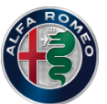
TRAFFICS DEEP DIVE
Traffic
PH_LKR_3
Source : GA4/Autobiz
December 2025

Slide 47
LEAD DEEP DIVE
By acquisition channel
PH_TBL
Source : Autobiz
December 2025

Slide 48
LEAD DEEP DIVE
By main website CTA
PH_TBL
Display the different CTA related to main website source
Source : Autobiz
December 2025

Slide 49
LEAD DEEP DIVE
By marketing code
PH_TBL
Source : Autobiz
December 2025

Slide 50

TRAFFICS DEEP DIVE
Traffic
PH_LKR_3
Source : GA4/Autobiz
December 2025

Slide 51
LEAD DEEP DIVE
By acquisition channel
PH_TBL
Source : Autobiz
December 2025

Slide 52
LEAD DEEP DIVE
By main website CTA
PH_TBL
Display the different CTA related to main website source
Source : Autobiz
December 2025

Slide 53
LEAD DEEP DIVE
By marketing code
PH_TBL
Source : Autobiz
December 2025

Slide 54
Agenda
EXECUTIVE SUMMARY
PERFORMANCE OVERVIEW
SALES PERFORMANCE
LEADS FOCUS
DEEP DIVE ANALYSIS
OPEN POINTS
APPENDIX
December 2025

Slide 55
MISCELLANEOUS ANALYSIS
Top 5 Purchase projects exPSA
PH_TBL
Source : autobiz, , Q4 2025
JAN 2025
Notes:
Evènements marquan

Slide 56
MISCELLANEOUS ANALYSIS
Top 5 Purchase projects exFCA
PH_TBL
Source : autobiz, Q4 2025
JAN 2025
Notes:
Evènements marquan

Slide 57
MISCELLANEOUS ANALYSIS
Trade-in vehicle by brands xP
PH_TBL

Slide 58
MISCELLANEOUS ANALYSIS
Trade-in vehicle by brands xF
PH_TBL

Slide 59
Agenda
EXECUTIVE SUMMARY
PERFORMANCE OVERVIEW
SALES PERFORMANCE
LEADS FOCUS
DEEP DIVE ANALYSIS
OPEN POINTS
APPENDIX
December 2025

Slide 60
OPEN POINTS
VISIBILITY
JOURNEY
IMPROVEMENT

Slide 61
OPEN POINTS
TRACKING
OPTIMIZATION
CRM
* Additional costs
Notes:
Share the most impactful CTA by brands
Focus Opel, additional CTA in the brand website

Slide 62
OPEN POINTS
REVENUE

Slide 63
Agenda
EXECUTIVE SUMMARY
PERFORMANCE OVERVIEW
SALES PERFORMANCE
LEADS FOCUS
DEEP DIVE ANALYSIS
OPEN POINTS
APPENDIX
December 2025

Slide 64
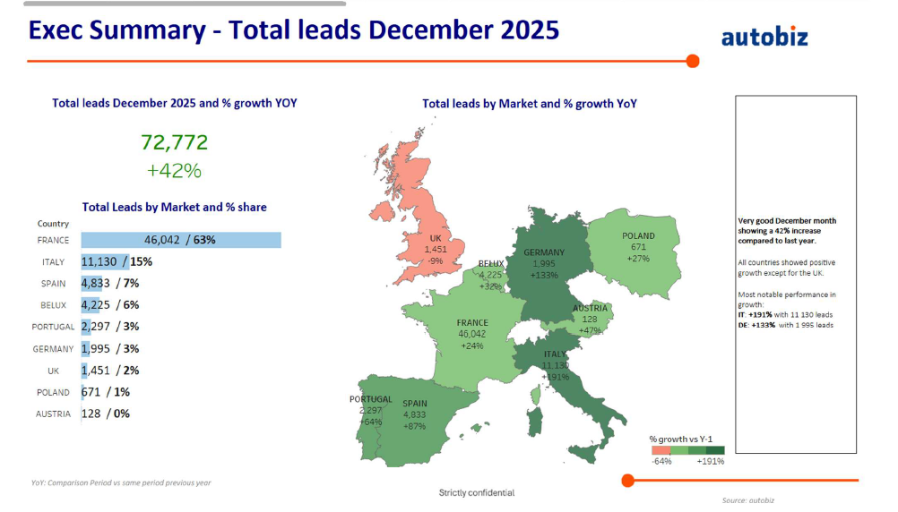

EXECUTIVE SUMMARY
All leads and growth Year-over-Year all markets
A MAJ
In terms of NC leads generated, Spain ranks on 3rd position.
There has been a 98% YoY growth for Spain NC leads.
NC leads have increased across all markets except Portugal, Belgique and Austria.
Source: autobiz

Slide 65
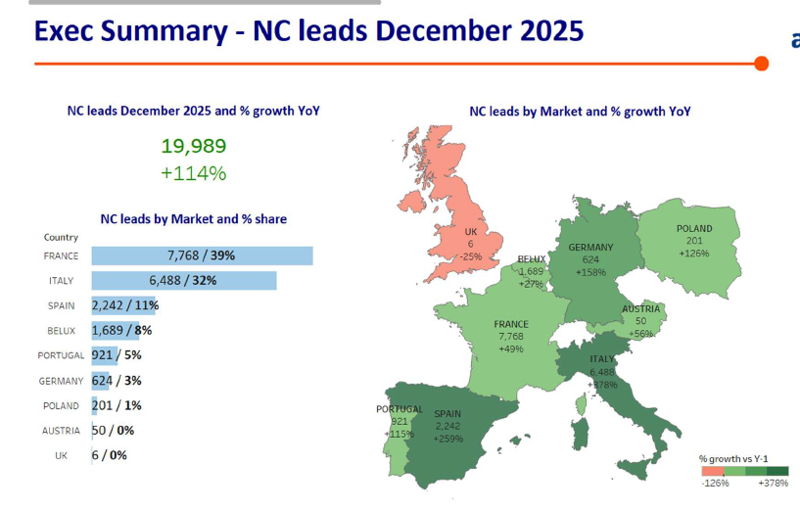
EXECUTIVE SUMMARY
NC leads and growth Year-over-Year all markets
A MAJ
In terms of NC leads generated, Spain ranks on 3rd position.
There has been a 98% YoY growth for Spain NC leads.
NC leads have increased across all markets except Portugal, Belgique and Austria.
Source: autobiz

Slide 66
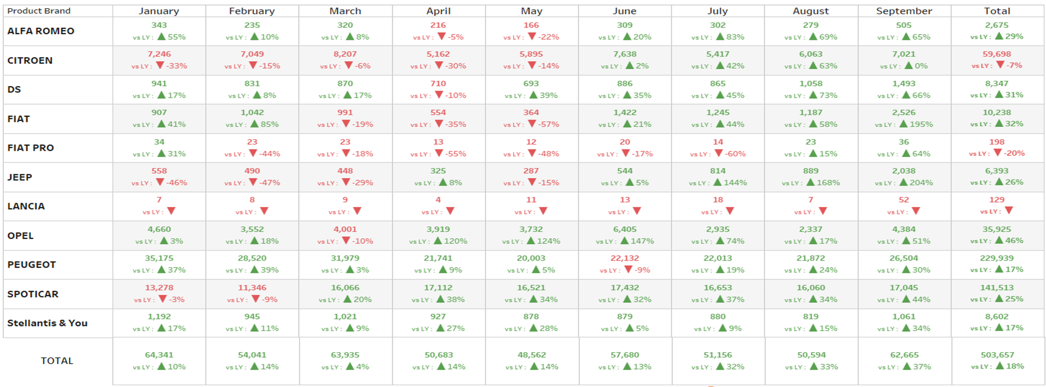
EXECUTIVE SUMMARY
Total leads and growth Year-over-Year
A MAJ
SP showed growth in both month-over-month (MoM) and year-over-year (YoY) evaluations.
NC leads represent 44% of the total leads generated, reflecting a 6 percentage point decrease compared to the previous month.
The leading contributor of leads for the month is Trade-in only with 45%.
Source: autobiz

Slide 67
EXECUTIVE SUMMARY
NC leads and growth Year-over-Year
A MAJ
SP showed growth in both month-over-month (MoM) and year-over-year (YoY) evaluations.
NC leads represent 44% of the total leads generated, reflecting a 6 percentage point decrease compared to the previous month.
The leading contributor of leads for the month is Trade-in only with 45%.
Source: autobiz

Slide 68
Contacts
Digital Key Account Manager team
dkam@autobiz.com

